Slide 1

JOB ORDER AND BOOKING SYSTEM
Project Proposal
Marlon Villarama, August 2025

Slide 2
The Problem We Are Solving
The business is growing and quickly expanding locations.
Multiple spreadsheets are used to manage customers and bookings.
Separate forms/systems are used to intake customer and booking data.
Data may be redundant across multiple stores, impacting integrity.
No/limited transaction audit trail/history.

Slide 3
The Solution
Create a single system to:
Quickly and easily access real-time data across the organization.
Unified data management for customers, service bookings, and employees.
Provide a continuous and complete view of a service booking’s life cycle.
Ensure data integrity and security.
Provide stakeholders with timely, accurate reports.

Slide 4
The Solution
Dispatch
Accounting
Reports
Customers
Quotations
Employees/Teams

Slide 5
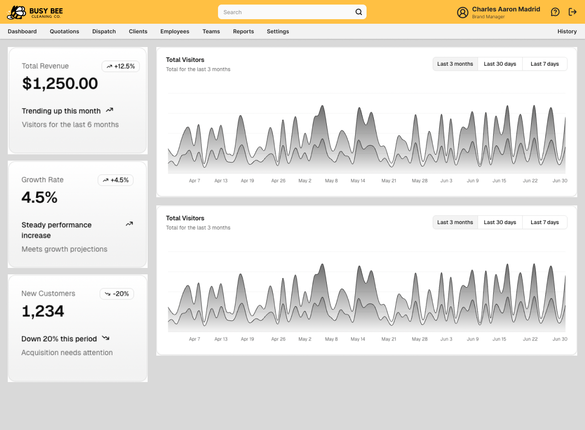
DASHBOARD

Slide 6
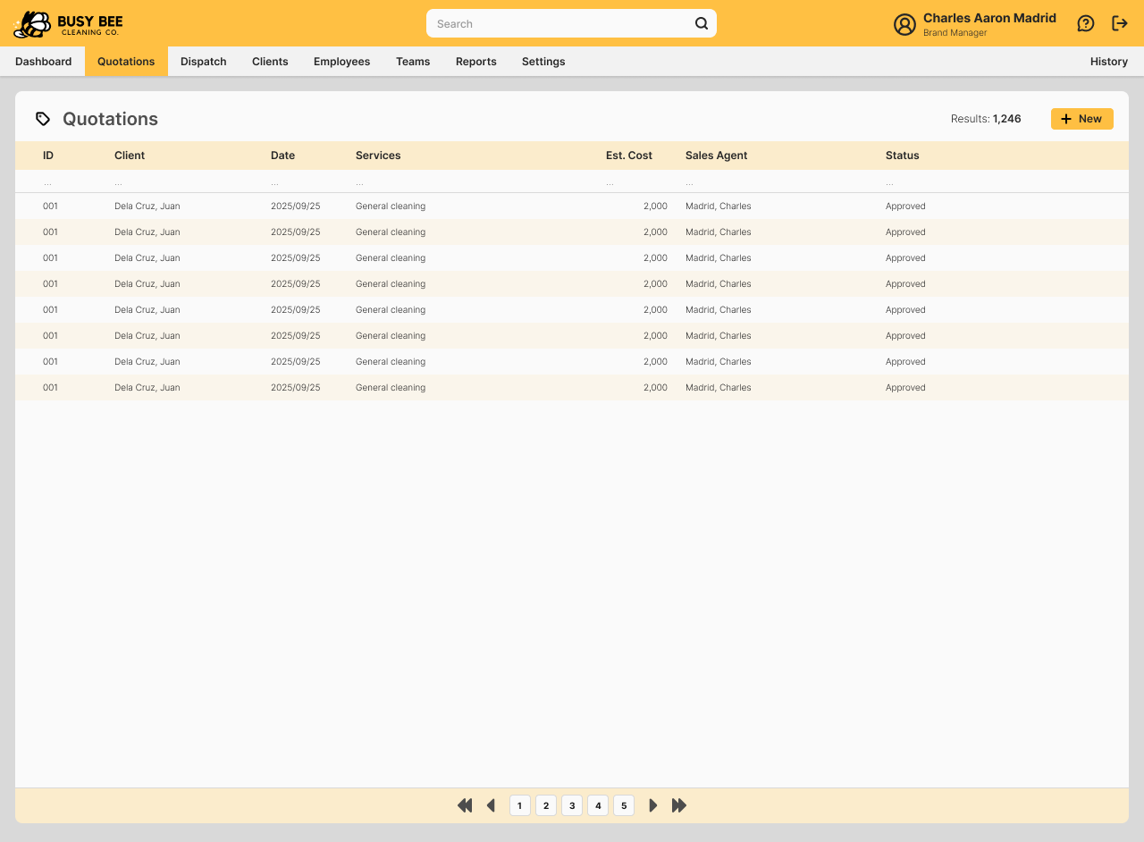
QUOTATIONS (List)

Slide 7
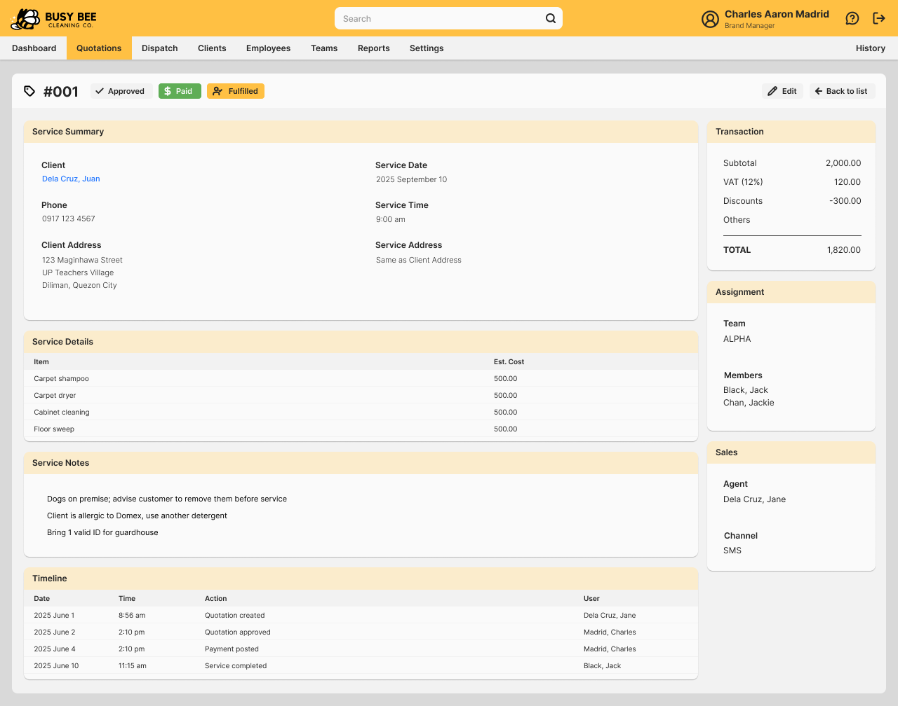
QUOTATION (View)

Slide 8
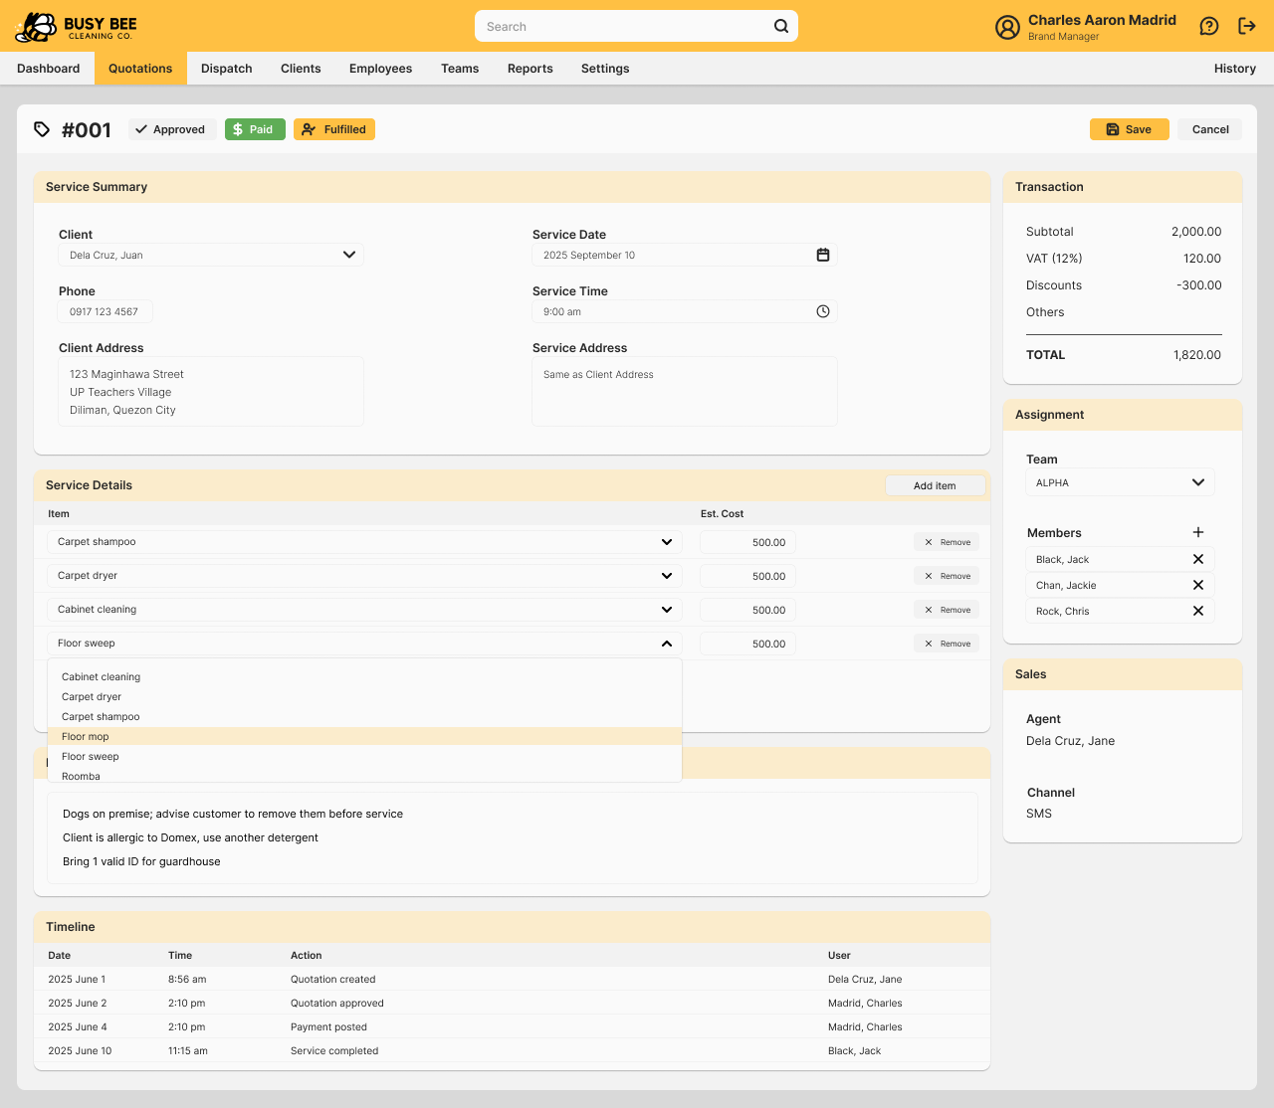
QUOTATION (Edit)

Slide 9
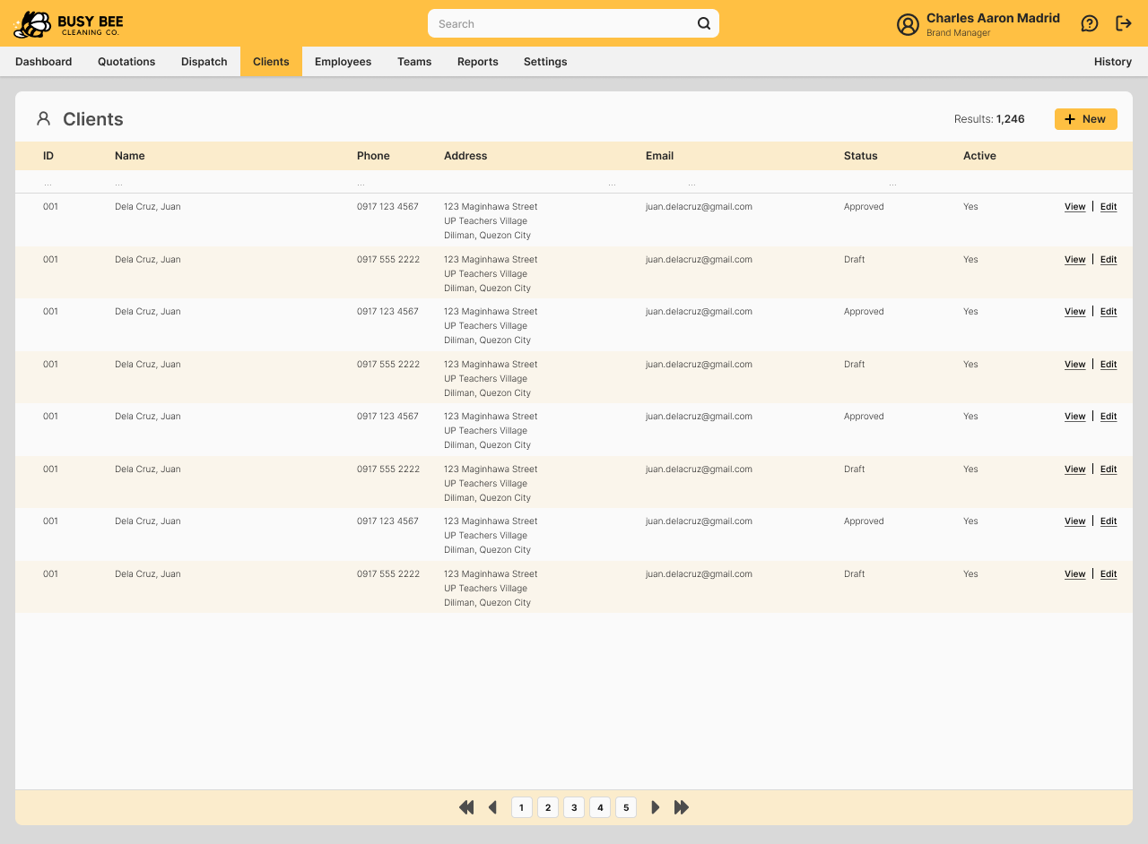
CLIENTS (List)

Slide 10
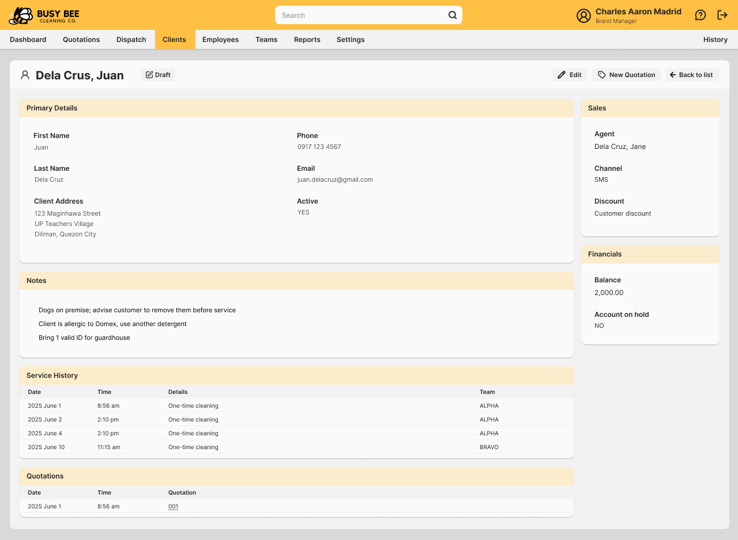
CLIENT (View)

Slide 11
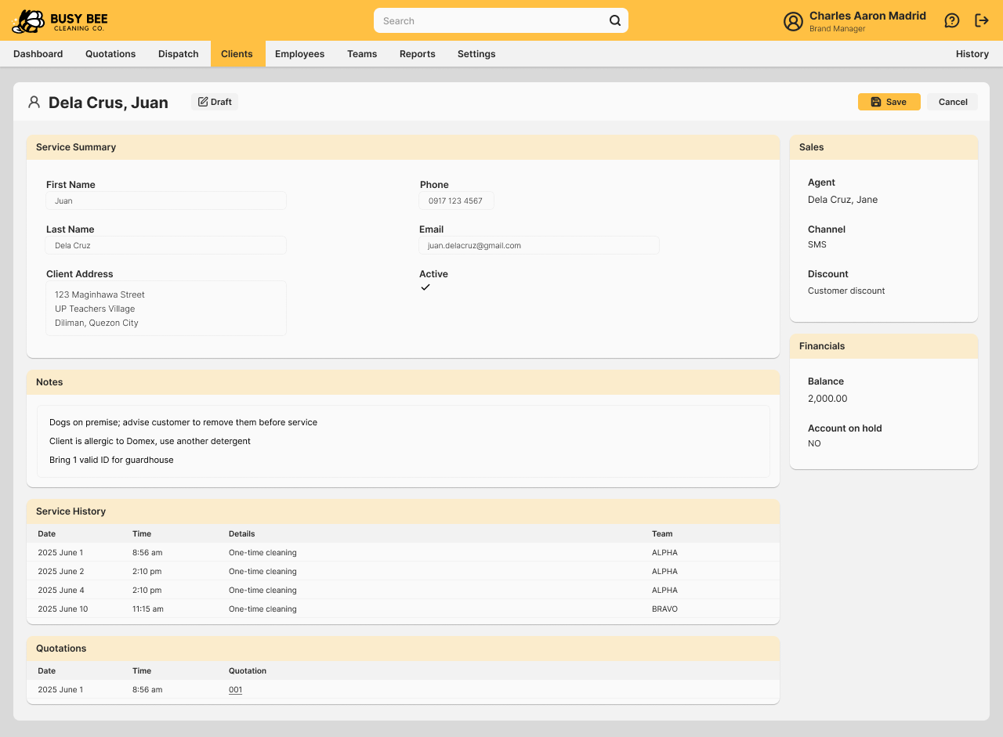
CLIENT (Edit)

Slide 12
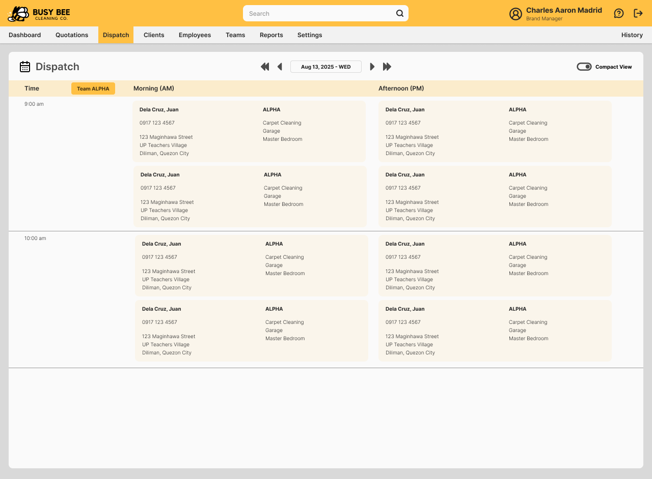
DISPATCH CALENDAR

Slide 13
Thank you!
Marlon Villarama
marlonsvillarama@gmail.com

